Slide 1
Chapter 1: Introduction
Prof. Yanwei Wu

Slide 2
Course Objectives
You will:
  Study the fundamental concepts of operating systems
  Practice the logical design using Java (or a programming language you feel comfortable)

Slide 3
Important Time Lines
Program 1: System calls and shell
Program 2: Scheduler
Midterm: Process Management
Program 3: Synchronization
Program 4: Paging
Final: Memory/File Management
(Check Moodle for their due dates.)

Slide 4
Course Info
Textbook
https://www.os-book.com/OS8/os8j/
Instructor’s info
email: wuya@wou.edu
office: ITC310-D
Assignments or course related materials will be posted on Moodle
Submit your assignment on Moodle

Slide 5
What is an Operating System?
A program that acts as an intermediary between a user of a computer and the computer hardware
Goals:
  Execute user programs and make solving user problems easier
  Use the computer system conveniently
  Use the computer hardware in an efficient manner
Definitions
  Resource allocator – manages and allocates resources
  Control program – controls the execution of user programs and operations of I/O devices
  Kernel – the one program running at all times (all else being application programs)

Slide 6
Computer System Structure
Four components:
  Hardware – provides basic computing resources
    CPU, memory, I/O devices
  Operating system
    Controls and coordinates use of hardware among various applications and users
  Application programs – define the ways in which the system resources are used to solve the computing problems of the users
    Word processors, compilers, web browsers, database systems, video games
  Users
    People, machines, other computers

Slide 7

Four Components of a Computer System

Slide 8
Operating Systems History
Batch systems:
Multiprogramming: IBM360
Time-sharing systems: Multics, Unix
Personal-computer systems: Windows, Linux
Symmetric multiprocessors
Dual-core system: Intel Core 2 Duo
Cluster systems: Hydra, PVM, MPI, MapReduce

Slide 9

Batch Systems
A job is assembled of the program, the data, and some control information (in control cards).
Programmers pass their jobs to an operator.
The operator batched together jobs.
OS transfers control from one job to another.
Each job output is sent back to the programmer.

Slide 10

Multiprogramming
Several jobs are kept in main memory at the same time.
OS picks one of them to execute.
The job may have to wait for a slow I/O operation to complete.
OS switches to and executes another job.
To facilitate multiprogramming, OS needs:
  Job scheduling
  Memory management

Slide 11

Time-Sharing Systems
This is a logical extension of multiprogramming.
Each user has at least one separate program in memory.
A program in execution is referred to as a process.
Process switch occur so frequently that the users can interact with each program while it is running.
File system allows users to access data and program interactively.

Slide 12
Personal-Computer Systems
Personal computers – computer system dedicated to a single user.
User convenience and responsiveness
Can adopt technology developed for larger operating systems’ some features.
At its beginning, a single user system did not need advanced CPU utilization and protection.
Later, file protection is necessary to avoid virus.
Overall, the same OS concepts are appropriate for the various different classes of computers.

Slide 13

Symmetric Multiprocessing Architecture
Multiprocessor systems with more than one CPU in close communication (in one box).
Tightly coupled system – processors share memory and a clock; shared-memory-based communication.
Advantages of parallel system:
  Increased throughput
  Economical
  Increased reliability

Slide 14

A Dual-Core Design
An MPU chip has two CPU cores, each:
  owning its own small L1 cache,
  sharing a large L2 cache, and
  accessing the main memory through L2.

Slide 15
Cluster Systems
Workstation
Client
  Takes a client-server model
Server
  Consists of many PC/workstations connected to a high-speed network or a storage-area network (SAN).
  Puts more focus on high-performance computing (HPC)
  serves for requests in parallel.
Workstation
Workstation
100Mbps
LAN
http server2
http server1
http server N
Master
node
Slave
1
Slave
2
Slave
N
1Gbps SAN

Slide 16
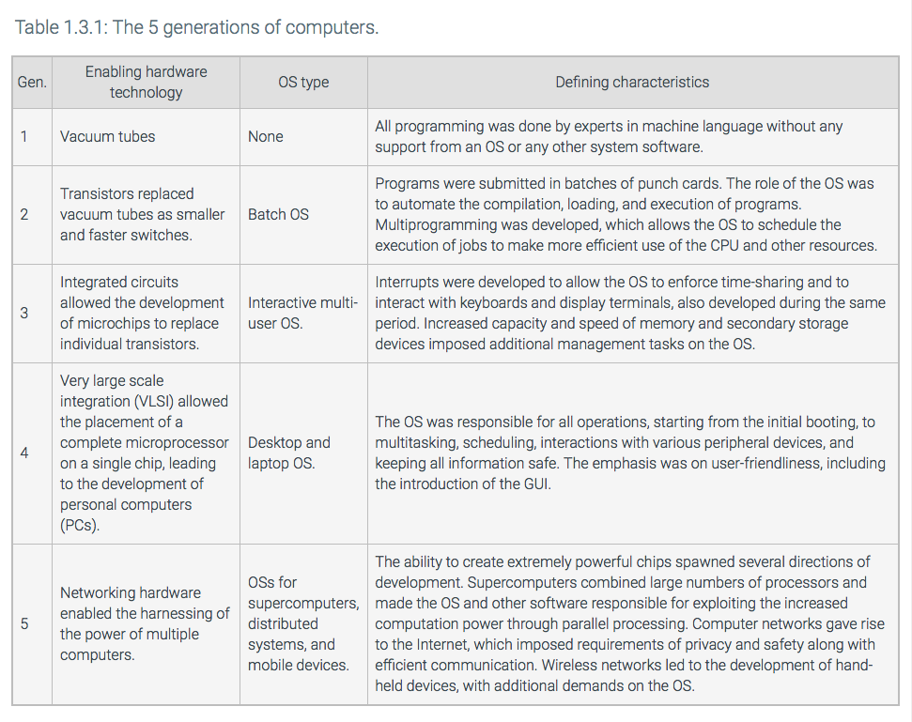

Slide 17

Computer Hardware

Slide 18
Synchronous I/O
During execution, each program needs I/O operations to receive keyboard inputs, open files, and print out results.
At the early computer era, a program had to wait for an I/O operation to be completed. (Synchronous I/O)
This frequently causes CPU idle.
requesting process
waiting
user
device driver
kernel
Interrupt handler
Hardware
data transfer
time

Slide 19
Async I/O and Interrupts
Asynchronous I/O returns control to a user program without waiting for the I/O to complete.
When the I/O is completed, an interrupt occurs to CPU that temporarily suspends the user program and handles the I/O device.
requesting process
continuing
user
device driver
kernel
Interrupt handler
Hardware
data transfer
time

Slide 20
Discussions 1
What tasks should OS perform in order to suspend and resume a program? List them.
Program suspension | Program resumption
1. 2. .. | 1. 2. ..

Slide 21
Hardware Protection
Purpose:
  With resource sharing, many programs could be affected by a bug in one program.
  Incorrect or malicious resource accesses cause a hardware trap to the operating system.
Dual-Mode Operation:
  User mode: no privileged instructions allowed.
  Kernel mode: Privileged instructions allowed.
I/O Protection: all privileged
Memory Protection: A region from the base to the limit register allowed to use
CPU Protection: CPU allowed to use until the timer gets 0.

Slide 22

Dual-Mode Operations
Provide hardware support to differentiate between at least two modes of operations.
  1. User mode – execution done on behalf of a user.
  2. Monitor mode (also supervisor mode, system mode, or Kernel mode) – execution done on behalf of operating system.
Switching between two modes
  Device interrupts, hardware traps, system calls cause a trap to the kernel mode
  The operating system returns to the user mode after servicing requests.

Slide 23

System Calls

Slide 24
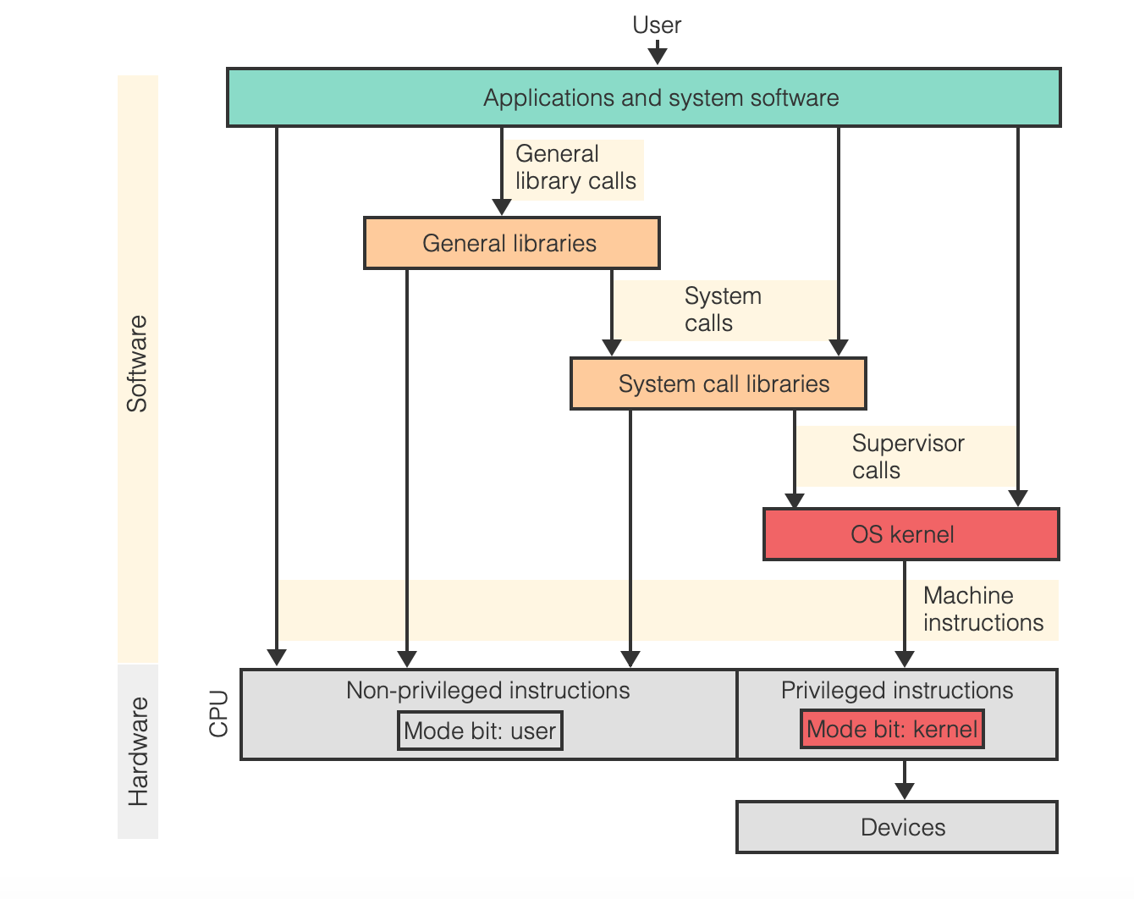

Slide 25
Discussions 2
List three distinct events upon which OS can get back CPU from the current user program.
1.
2.
3.

Slide 26

A View of Operating System Services

